Slide 1




InnovAct 2025
CropX
CropX - A Sustainable IoT Rover for Modern Agriculture
Track : IoT
Innovation Id : IR2025-996003
Team Members:
Krishna Jawandhiya ( 22BEC0790 )
Vasu Johri( 22BEC0978 )
Jyotiraditya Kale ( 22BCE0292)
Hussain Lokhandwala (22BIT0620)
Esther Samuel (22BEC0853)

Slide 2




CropX
01.
02.
Fires damage crops and increase losses
Farmers face labour shortages and high costs
03.
Irrigation is inefficient and leads to water wastage
04.
No compact system solves all problems together.
05.
Unpredictable climate reduces
yield and reliability.
06.
There is a need for a smart and affordable farming assistant.
Problem

Slide 3
CropX
Relevance
Agriculture is the backbone of food security
70% of freshwater is used in farming
Over-irrigation damages soil and reduces profit.
Automation makes farming efficient and sustainable.

Slide 4
Our rover irrigates crops automatically when soil moisture is low.
CropX
Proposed Solution
It detects fire in the farm and puts it out instantly.
It monitors soil, temperature, and humidity in real time.
The rover can be controlled remotely through WiFi or Bluetooth.

Slide 5
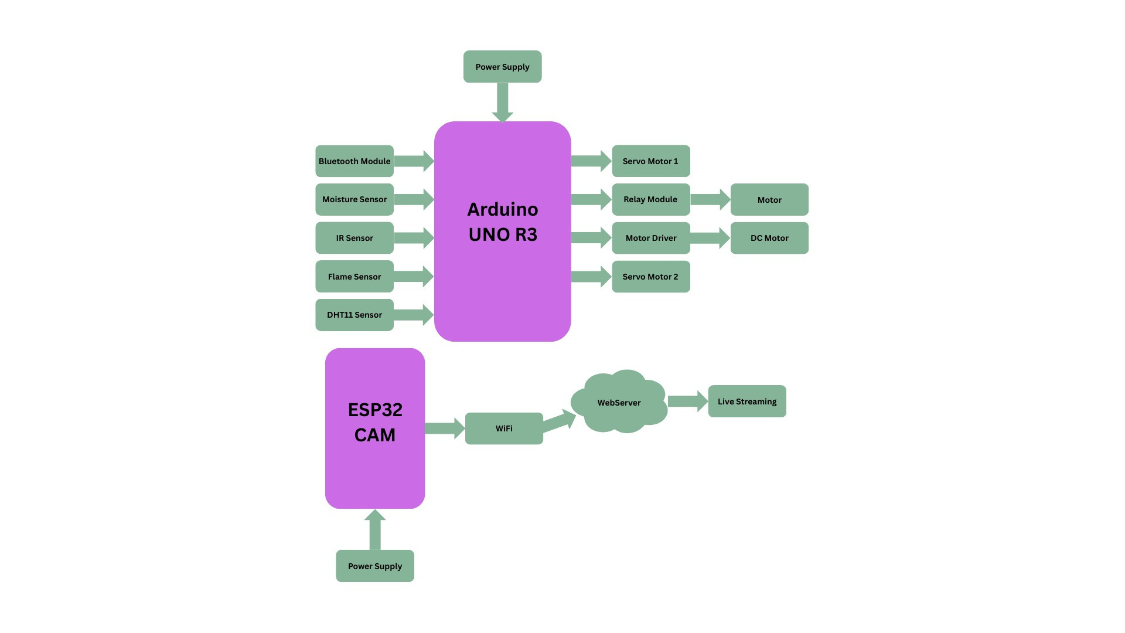
CropX
Proposed diagram

Slide 6

CropX
Distinctive
Features
Unlike existing tools, Cropx rover combines multiple functions in one system.
ESP32 camera streams live farm video.
Obstacle detection improves reliability.
The rover runs on solar power, making it eco-friendly and cost-efficient.
Dual communication ensures it works in both rural and urban settings.
It can adapt to any crop type, farm size, or geography.

Slide 7
CropX
Flame sensor is connected to a water pump for fire safety.
solar powered for sustainable farming.
ESP32 camera streams live video feed.
WiFi and Bluetooth enable dual control.
ADAS minimizes accidents and improves comfort.
Arduino UNO as the main controller.
Moisture and DHT 11 sensors guide irrigation
Technical Approach

Slide 8
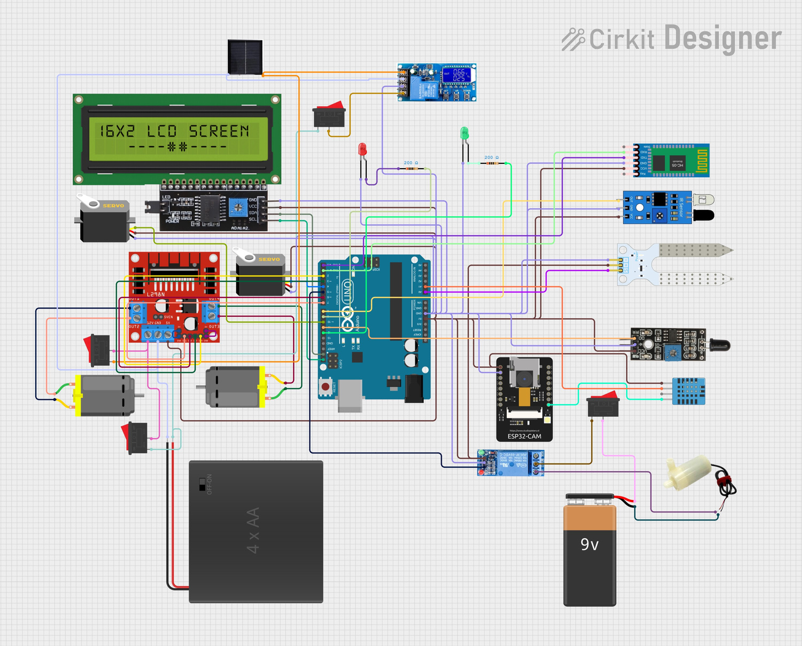
CropX
Architecture Diagram

Slide 9
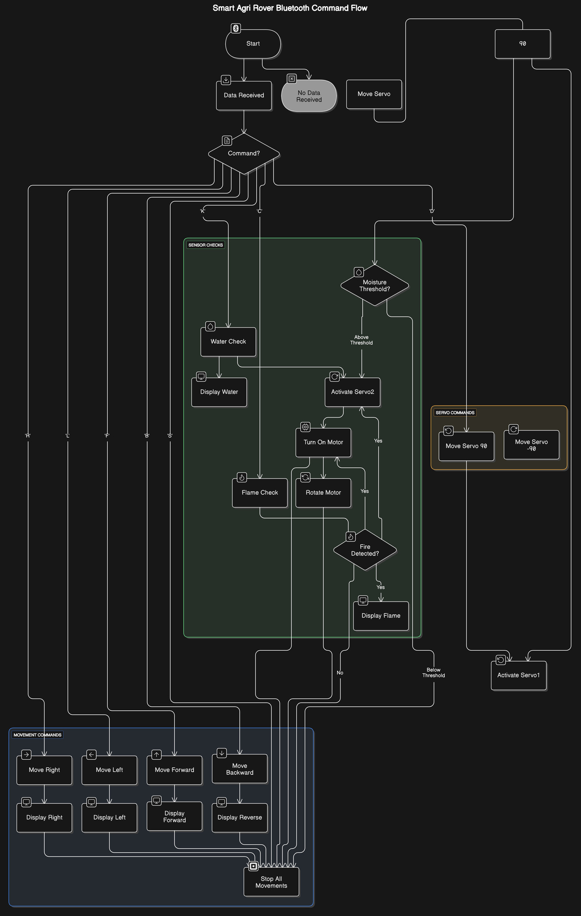
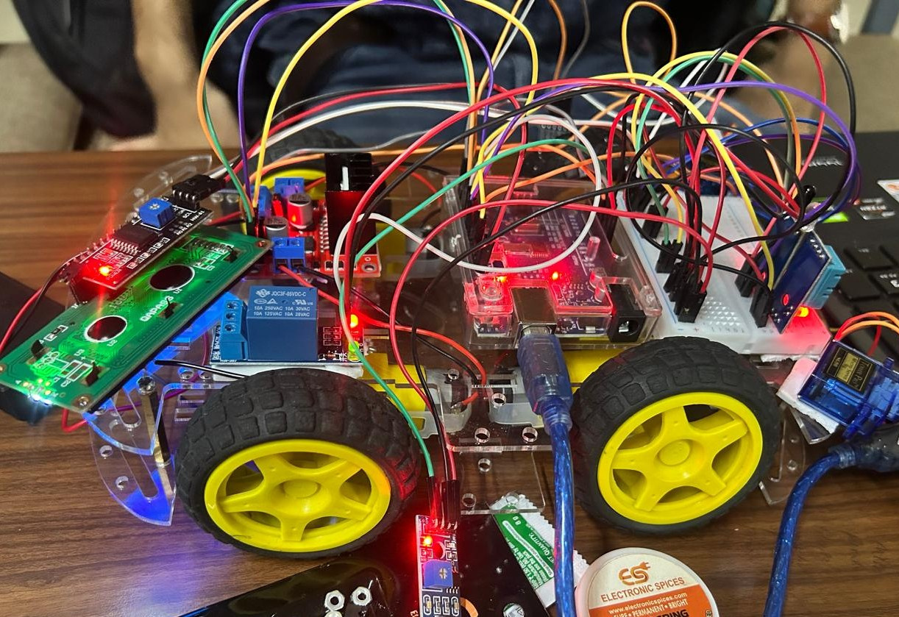
CropX
Prototype with workflow

Slide 10
Saves up to 60% water compared to traditional irrigation.
CropX
Prevents crop loss from fire hazards.
Impact
Boosts yield while lowering costs.
Remote supervision reduces labour dependency.
Aligns with the United Nations 2030 Agenda particularly UN SDG 2 (Zero Hunger) & SDG 12 (Responsible Consumption & Production).

Slide 11
CropX
Challenges & Solutions
Power supply was a challenge, solved with solar energy.
Connectivity issues solved using dual WiFi + Bluetooth
Costs reduced by low-cost sensors and open source tech
Durability was addressed through compact and rugged design.

Slide 12
CropX
Future Scope
Integrating AI for predicting crop yield and diseases.
Drones can work with the rover for aerial monitoring.
Cloud computing dashboard can help farmers manage large farms.
Current cost is around ₹3,900 and for large-scale advanced deployment, the cost maybe rise according to market needs.

Slide 13
CropX
CropX rover is a one-stop solution for modern precision farming. It is sustainable, affordable, and adaptable to many conditions. The scalable design ensures it is accessible not only to large farms but also to smallholder farmers, who form the backbone of food production worldwide.
Conclusion

Slide 14

CropX
Acknowledgements
We thank our team members and mentors for their support.
Special thanks to InnovAct 2025 for this platform.
We dedicate this innovation to farmers who inspire change.
For More Information, please visit:
https://github.com/JOHRIVASU/IICHackathon

